Slide 1
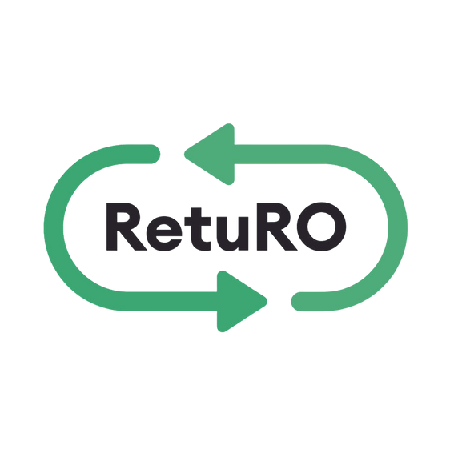

INSTRUCTIONS REGARDING
Registration of products/containers in the Packaging Registry
FOR PRODUCERS
Version updated _ March 28 , 2025

Slide 2
Content
Evidence Review
1. | Scope​​
2. | Sign in
3. | Product registration process
3.1. | Single product registration
3.2. | Mass product registration
4. | Registration status tracking
5. | Table with field description

Slide 3
INSTRUCTIONS FOR PACKAGING REGISTRATION
Evidence Review
March 28, 2025
  Chapter 5. Product Field Table , row​​ 22.
  Expected date of placing on the market must to be in format correct [DD/MM/YYYY]
  Chapter 3. Product registration process
  [Please note that container measurement fields can be completed with or without decimals. To avoid errors, we recommend inserting the same number of decimals for all fields, even '0.00' if no decimals are required.]
May 31, 2024
  Chapter 3. Product registration process
  [Once the products have been submitted for approval, you must send an Excel database to produse@returosgr.ro (exported from the entity/entities issuing barcodes in EAN-13/EAN-8 symbology, based on the SR ISO/IEC 15420:2013 standard). This database must contain the barcodes submitted for approval.]
.

Slide 4
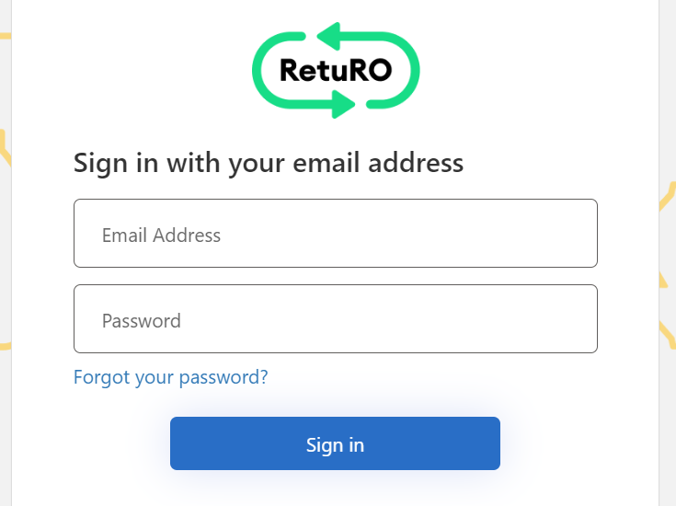
INSTRUCTIONS FOR PACKAGING REGISTRATION
Scope
The purpose of this document is to provide advice for producers who register SGR products in the RetuRO Register for their SGR packaging.
You can choose to manually record products one by one or bulk upload them using our CSV template. By using the template, you can add multiple products to the file before registration and upload them all at once.
This document provides step-by-step instructions for both product registration options, as well as a detailed table of required fields for reference.
2. Log in
To start the packaging registration, you must first log in to your RetuRO manufacturer account.
Please enter your registered email address and password to log in. If you have forgotten your password, select "Forgot Password" and you will receive an email with instructions to reset your password and log in successfully.
.​
1

Slide 5
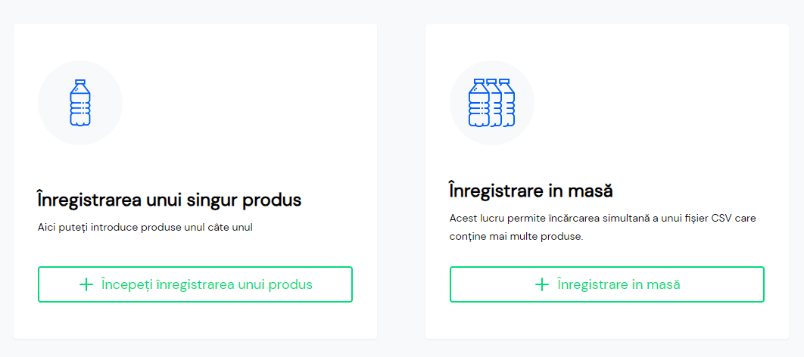
INSTRUCTIONS ON PACKAGING REGISTRATION
3. Packaging registration process​​
Once you are successfully connected, you can start the registration process.
You have two registration options:
Single Product/Packaging Registration – This option allows you to manually register products one by one.
Bulk Product Registration – This option allows you to download our CSV template, add multiple products, and upload all products at once in CSV format.
You can register some products using the Bulk Product Registration option and add others using the Single Product Registration option. Manufacturers may prefer the Bulk Upload option before going live, as they have multiple products to register at once, and then switch to the Single Product Registration option to add new products after going live.
It is entirely up to you to choose the method that works best for you and your company.
2

Slide 6
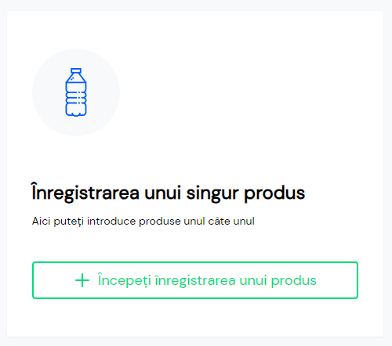
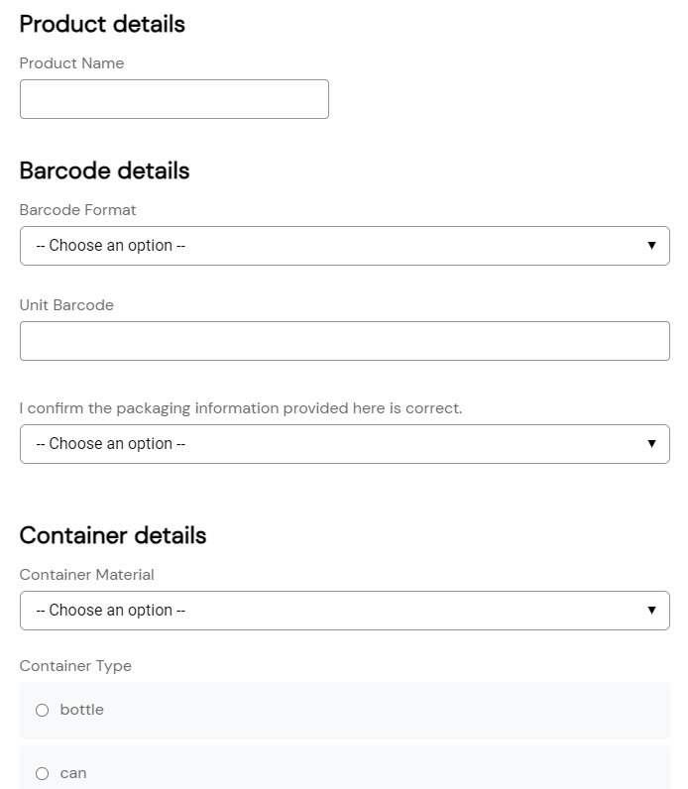
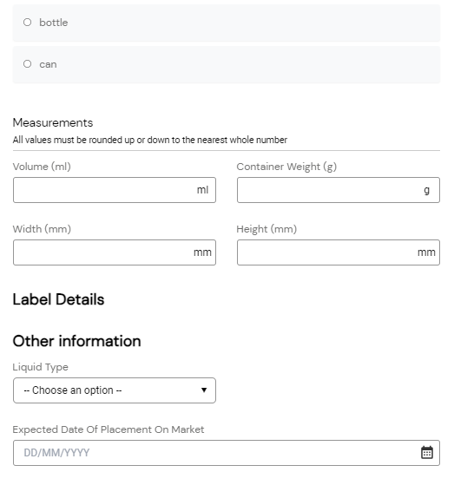
INSTRUCTIONS FOR PACKAGING REGISTRATION
3.1 Single product registration
This section provides details for a single product registration. This method allows products to be detailed in the web form, one by one.
Once you start the Single Product Registration, you will see a number of required fields that need to be filled in. In Section 5 of this document, you will find a detailed table of product fields. This table includes details for each required field and will help you complete the registration for your container and product type.
3

Slide 7
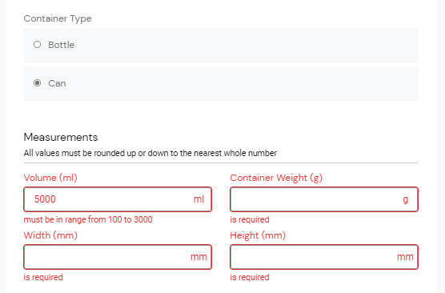

INSTRUCTIONS FOR PACKAGING REGISTRATION
Container Dimensions: Please note that container measurement fields can be completed with or without decimals. To avoid errors, we recommend inserting the same number of decimals for all fields, even '0.00' if no decimals are required.
If you enter data that requires correction, you will see a red error message . You must correct all errors before you can submit the product for approval.
"A single product's registration data can be saved for later modification or review by clicking 'Save as Draft'. Once all required fields have been completed, you can select 'Submit for Approval'. Please ensure that you review all the information provided to confirm its accuracy before submitting the product for approval. Special attention should be given to the barcode and the fields where measurements are entered. Once a product has been submitted for approval, it cannot be modified or edited.
Once the product has been sent, RetuRO will analyze and choose one of the following:
Approve : This means your product has been successfully added to the SGR Packaging Registry.
Cancel : This means that your product has not been approved. The reason for the cancellation will be sent to you via email.
Submitted for correction - This means that something needs to be corrected before your product can be approved. You will receive an email describing the issue and will have the opportunity to edit the product and resubmit it for approval.
4

Slide 8
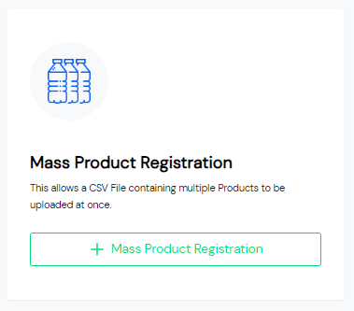
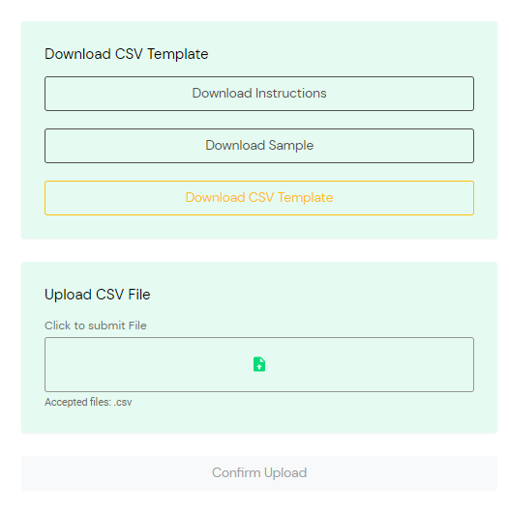
INSTRUCTIONS FOR PACKAGING REGISTRATION
3.2 Mass product registration
This section provides details on bulk product registration. This method allows you to download our CSV template, add multiple products, and upload them all at once in CSV format.
Once you start Bulk Product Registration, you will be able to access 3 useful documents that will help you upload your products for registration.
Bulk upload instructions
Mass loading sample
CSV bulk upload template
5

Slide 9
INSTRUCTIONS FOR PACKAGING REGISTRATION
Loading Instructions in Table
This document includes detailed instructions for completing and loading a CSV file. We recommend that you download and read this document before adding products to the CSV file. The instructions include full details about the required fields and how to enter the correct details for each product.
If you are already familiar with working with CSV files, you know that even a small mistake, such as a missing comma (,) or an extra period (.), can cause errors. By carefully following these instructions, you will avoid errors and unnecessary confusion.
Please note that there may be multiple tabs at the bottom of this document. Be sure to review each tab.
Loading Example in Table
This document contains an example of a CSV upload file in table format. You can use this file as a useful reference when adding products to the CSV upload table.
CSV Upload Template in Table
This CSV template is provided for you to download, "save as," and enter your product data. Once you have added all products and completed all the fields, save the file, and you’ll be ready for loading.
Note important - Please note that container measurement fields can be completed with or without decimals. To avoid errors, we recommend inserting the same number of decimals for all fields, even '0.00' if no decimals are required.
To load the CSV file, click to send the file in the 'Submit File' box, then select 'Confirm Upload' (Confirm loading).
If the file is in an incorrect format, you will see a red error message in the top right corner of the screen. This is most likely due to the fact that the document is not in the required CSV format (see the following illustration).
If the file is successfully loaded, you will see a green confirmation message in the top right corner of the screen.
6

Slide 10
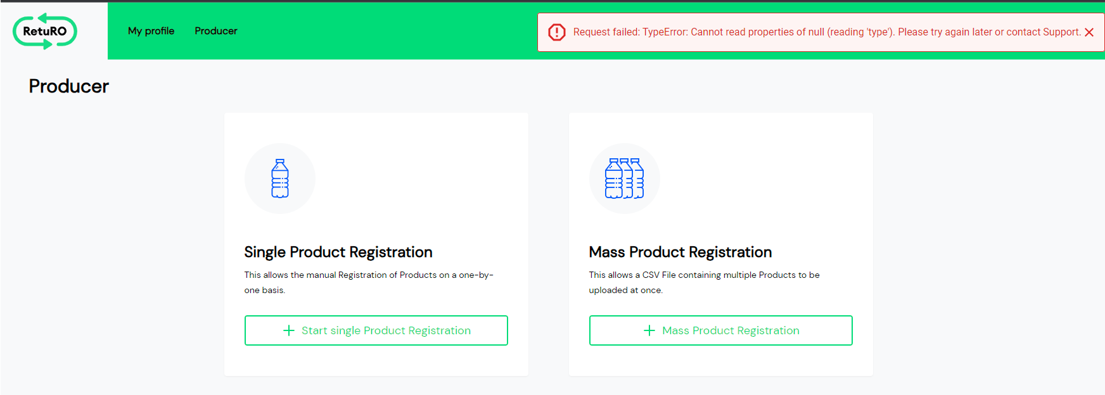
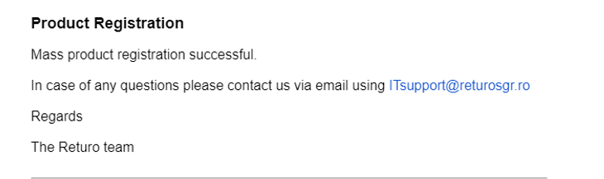
INSTRUCTIONS FOR PACKAGING REGISTRATION
Confirming that your file was successfully uploaded does not mean that it is error-free. It simply confirms that your file was uploaded to the system.
You will receive an email after you upload your file. This email will indicate whether your products were successfully uploaded or not.
Successful confirmation email - If all the fields in the CSV are filled incorrectly, you will receive an email confirming the mass registration of the product. At this point, you should move on to the next step - Submit the product for approval.
Failed Registration Email - If any field in the CSV contains errors, you will receive an email informing you that the bulk product registration failed. The email will provide details about the error. Please correct all errors and re-upload the CSV.
Please note - the CSV file may contain several errors that are not included in the first email you receive. Please continue to correct the errors as per the details in the emails and re-upload until you receive the confirmation email informing you that the bulk product registration has been successfully completed.
Example of a successful confirmation email:
7

Slide 11
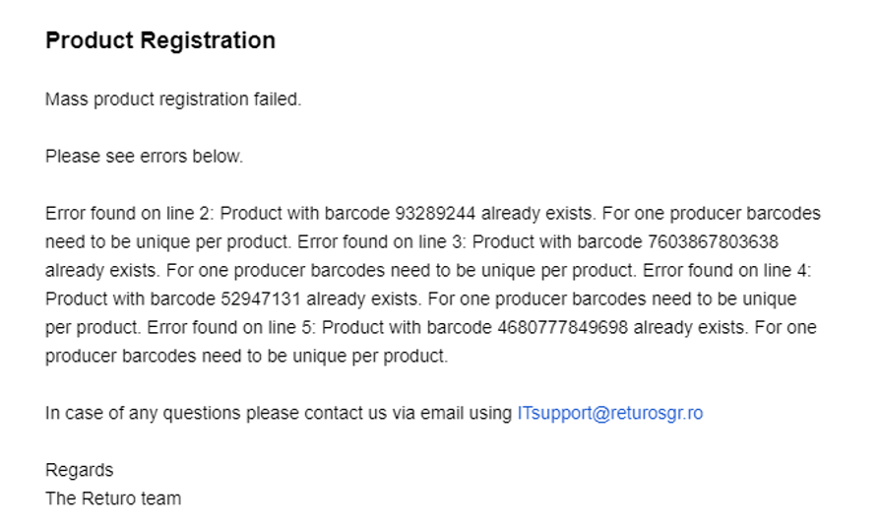
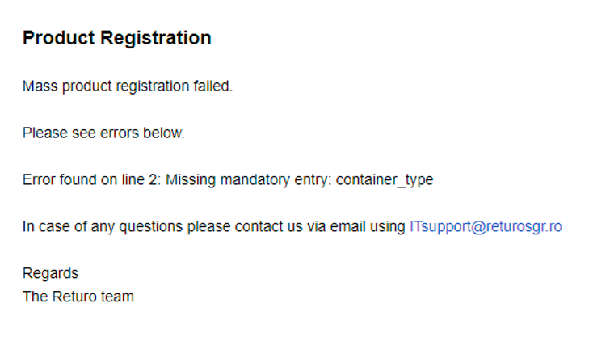
INSTRUCTIONS FOR PACKAGING REGISTRATION
Examples of failed registration emails:
Once the products have been successfully uploaded, they will be available in the 'Products' tab on the Manufacturer page in the registration portal.
Important: Don't forget to submit them for approval!
Please note that all products uploaded via CSV are set to 'Imported' status, and an action to 'Submit for Approval' is required. RetuRO will not review products for approval until they have been submitted.
8

Slide 12
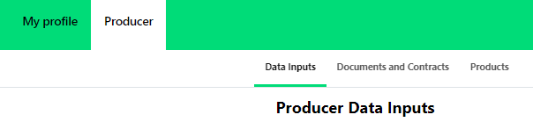
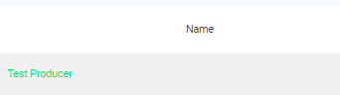
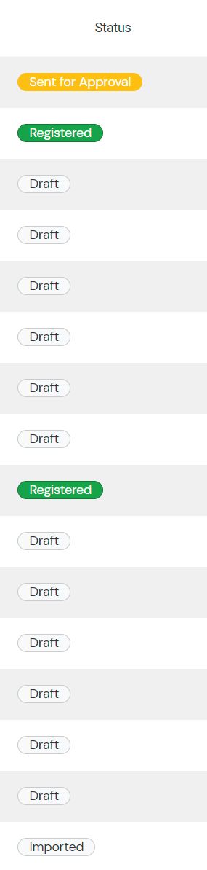
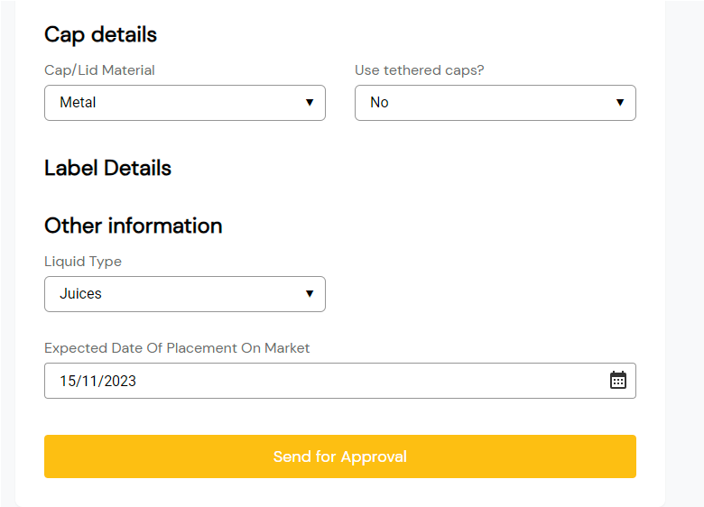
INSTRUCTIONS FOR PACKAGING REGISTRATION
Once the bulk upload of products is complete, you need to submit each product for approval. You will find the full list of products in the 'Products' tab on the Manufacturer page in the registration portal.
Please check the status of all products. All products listed as "Imported" require action and must be submitted for approval.
To submit your uploaded products for approval, click on the product name to display its details. Scroll down until you see the "Submit for Approval" option.
Please make sure to submit all "imported" products for approval. RetuRO will not review or approve the product until it is submitted for approval.
9

Slide 13
INSTRUCTIONS FOR PACKAGING REGISTRATION
Once the products have been submitted for approval, you must send an Excel database to produse@returosgr.ro (exported from the entity/entities issuing barcodes in EAN-13/EAN-8 symbology, based on the SR ISO/IEC 15420:2013 standard). This database must contain the barcodes submitted for approval.
RetuRO will review the submission and choose one of the following options for each product:
  Approved: This means your product has been successfully added to the SGR Packaging Register.
  Canceled: This means your product has not been approved. The reason for cancellation will be sent to you via email.
  Sent for Correction: This means that some adjustments are required before the product can be approved. You will receive an email describing the issue, allowing you to edit the product and resubmit it for approval.
4. Tracking Registration Status
You can follow up on the registration status of your packaging and the approval status of all products in the Products tab on the Manufacturer page within the registration portal.
Please review the list of possible statuses along with their descriptions below.
 | Project - When recording products using the Unique Product Registration option, a product can be saved in "Draft" status before being submitted for approval. A draft product can be modified.
 | Imported - When recording products using the Mass Product Registration option (in the product table), the products are automatically saved with the status "Imported". Each product must be edited individually before it can be "Sent for approval”.
 | Submitted for approval - the status 'Sent for approval' means that the product was sent to RetuRO for review and approval.
 | Submitted for correction - the status 'Sent for correction' means that the product has been reviewed by RetuRO, and necessary corrections must be made before the product can be approved. You will receive an email describing the problem, and you will have the ability to edit the product and send it back for approval.
 | Registered - the status 'Registered' means that the product has been successfully approved and added to the SGR Packaging Register. A confirmation email will be automatically generated, confirming that the product has been registered
 | Cancelled - the status 'Cancelled' means that the product was not approved. The reason for the cancellation will be sent to you by email..
10

Slide 14
INSTRUCTIONS FOR PACKAGING REGISTRATION
5. Product Fields Table​​
 | Bulk upload CSV column | Field name | Description
1 | C | Product name | Commercial product name
2 | D | Barcode format | 8 digits​​ or 13 digits​​
3 | It is | Barcode | Unique SGR barcode number
4 | F | Confirm that the container details are correct | one option​​ accepted "YES"
5 | G | Container material | Aluminum , Steel , Pet, Glass
6 | H | Container type | Bottle /One box (
7 | and | Container barriers | DISPLAYS only for PET PET transparent/Green/ Blue /Brown/ Other
8 | J | Container barrier type | Only displayed for single-layer/multilayer PET
9 | K | Container volume (ml) | number whole , >=100ml and <=3000ml
10 | IT | Container color | Show only for PET PET transparent/Green/Blue/Brown/Other
11 | M | Container weight (g) | integer, >0 and <2,000g
12 | N | Lid weight (g) | Shows only for Whole number bottles, >0 and < 50g
13 | A | Tank height without lid/wallpaper (mm) | Shows only for Bottle integer, >100mm and < 1000 mm
14 | P | Container height with lid/wallpaper (mm) | Shows only for Bottle integer, >100mm and < 1000 mm
15 | Q | Container width (mm) | integer, >20 mm and < 1000 mm
16 | R | Lid/cap material | Shows only for Bottle PP/PE/ALU/Metal/Other plastic
17 | S | Do you use Tethered Caps? | Bottle only shows YES/NO
18 | T | Label type | Shows only for Bottle Corp partial/total
19 | U | Label material | Shows only for Bottle Metal foil/OPS/PS/PLA/OPP/PP/PE/Paper/ PET/PVC/Other (specify)
20 | V | Material label if "Other" | Shows only for Bottle was selected above "other", specify type
21 | W | Liquid type | Beer , beer mixes , drink mixes​​ alcoholic beverages , cider , other beverages fermented , juices , nectars , drinks soft drinks , mineral waters and drinking water of any kind food , wines and SPIRIT
22 | X | Expected market launch date​​ | DD/MM/YYYY
yourself Please saddle remember :
Many from FIELDS present in the table above will​ display only for a specific type of material or container. You will not always be asked saddle complete all FIELDS DISPLAY in field table​ for products . This table is MEANT saddle OFFER only information ADDITIONAL and guidelines .
The CSV is filled out in the language English according to “ mass_upload_instructions ” which you download from the “ Register” section Packaging " section " Loading​​​​​ in the mass " .
11

